Slide 1
Open Science, Open Practice: Implications for Industrial-Organizational Psychology (and Beyond)
Dr. Fred Oswald
President, SIOP (Div. 14)
Rice University
Presented August 5, 2017 125th Annual APA Convention, Washington DC

Slide 2
*
(a star-struck researcher)

Slide 3
* = publication,
tenure, attention,
glory, $
← A star-struck researcher
who engaged in questionable research
practices (known, under-appreciated, or
unknown).

Slide 4
Openness in Science and Practice
Why discuss this topic?
Because of grad students
Implications for education
Formative years (develop good habits and influence our science/practice early)

Slide 5
Openness in Science and Practice
Why discuss this topic?
Because of grad students
Implications for education
Formative years (develop good habits and influence our science/practice early)
Because of me
SIOP’s Robust and Replicable Research Task Force
new Associate Editor of AMPPS
personal desire to make changes in how we (and I) conduct research
…and Go Team SIOP! ☺

Slide 6
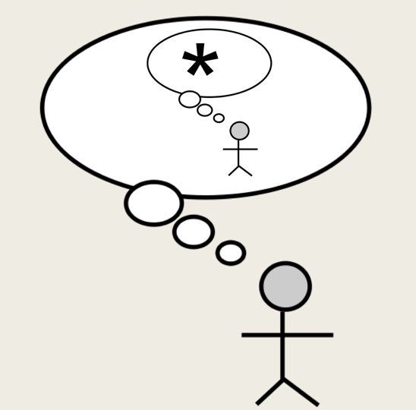
What are the goals of open science?
From SIOP’s new RRR Task Force (Steven Rogelberg, Chair)
Relevant
Rigorous
Replicable
Transparent
Theory-Driven
Accumulative
Predictive
(also see NSF’s statement on RRR)
(reflecting on being star-struck)

Slide 7
What are the goals of open science?
From SIOP’s new RRR Task Force (Steven Rogelberg, Chair)
Relevant – Accurate and useful scientific explanations
Rigorous
Replicable
Transparent
Theory-Driven
Accumulative
Predictive

Slide 8
What are the goals of open science?
From SIOP’s new RRR Task Force (Steven Rogelberg, Chair)
Relevant
Rigorous – Sound methodologies (both deductive and inductive)
Replicable
Transparent
Theory-Driven
Accumulative
Predictive

Slide 9
What are the goals of open science?
From SIOP’s new RRR Task Force (Steven Rogelberg, Chair)
Relevant
Rigorous
Replicable – Valuing replication (strict vs. conceptual); and let’s not forget our methodological history here (cross-validation, generalizability theory, meta-analysis)
Transparent
Theory-Driven
Accumulative
Predictive

Slide 10
What are the goals of open science?
From SIOP’s new RRR Task Force (Steven Rogelberg, Chair)
Relevant
Rigorous
Replicable
Transparent - Make everything available when allowable; report everything regarding process and outcomes. (online supplements makes this ever more possible)
Theory-Driven
Accumulative
Predictive

Slide 11
Transparency: How transparent will we become?
Wicherts et al. (2006) contacted 141 psychology researchers to share their data from papers published less than a year go, for the purpose of reanalysis, as is required by APA journal policy.
Only 38 (27%) shared some of their data.
I’ve also run into this problem.

Slide 12
Transparency: How transparent will we become?
Openly sharing data leads to higher citations for their associated studies (Leitner et al., 2016).
Journals might increase their integrity by embracing transparency. Authors can access/analyze data sets, catch errors, offer extensions, etc.
But what people who worked VERY hard for their data. Should they immediately share those data? Or how to determine an embargo period?
What about researchers falling back on proprietary or ethical/privacy issues, vs. negotiating to be as transparent as possible?

Slide 13
What are the goals of open science?
From SIOP’s new RRR Task Force (Steven Rogelberg, Chair)
Relevant
Rigorous
Replicable
Transparent
Theory-Driven – Use theory to improve knowledge and outcomes (NOT as an end in and of itself). Less theory, more inductive research? (exploratory analysis, big data + theory/thinking)
Accumulative
Predictive

Slide 14
What are the goals of open science?
From SIOP’s new RRR Task Force (Steven Rogelberg, Chair)
Relevant
Rigorous
Replicable
Transparent
Theory-Driven
Accumulative – Integrate, compare, contrast scientific findings across sources
Predictive

Slide 15
What are the goals of open science?
From SIOP’s new RRR Task Force (Steven Rogelberg, Chair)
Relevant
Rigorous
Replicable
Transparent
Theory-Driven
Accumulative
Predictive – Predict future outcomes, individual and group levels; ties to big data modeling, but with all of the above taken into accounts as well

Slide 16
By the way…can these goals contribute to open practice?
Relevant
Rigorous
Replicable
Transparent
Theory-Driven
Accumulative
Predictive

Slide 17
OK, so we have open science principles, but what can we actually do?
Improve our journals
Improve our tools
Improve our awareness
Improve our culture
Improve collaboration
Keep it all in perspective

Slide 18
OK we have open science principles, but what can we actually do?
Improve our journals Change editorial cultures, increase reviewer training
Improve our tools
Improve our awareness
Improve our culture
Improve collaboration
Keep it all in perspective

Slide 19
OK we have open science principles, but what can we actually do?
Improve our journals
Improve our tools Learn R, grad students!
Improve our awareness
Improve our culture
Improve collaboration
Keep it all in perspective

Slide 20
OK we have open science principles, but what can we actually do?
Improve our journals
Improve our tools
Improve our awareness Keep an eye on fast-moving OS across disciplines
Improve our culture
Improve collaboration
Keep it all in perspective

Slide 21
OK we have open science principles, but what can we actually do?
Improve our journals
Improve our tools
Improve our awareness
Improve our culture Make open science part of SIOP; see the SIOP 2017 guide to Reproducible Research: http://www.siop.org/tip/april17/rr.aspx
Improve collaboration
Keep it all in perspective

Slide 22
OK we have open science principles, but what can we actually do?
Improve our journals
Improve our tools
Improve our awareness
Improve our culture
Improve collaboration Joint activities where academics work with practitioners and adopt open science approaches
Keep it all in perspective

Slide 23
OK we have open science principles, but what can we actually do?
Improve our journals
Improve our tools
Improve our awareness
Improve our culture
Improve collaboration
Keep it all in perspective Remember our history. Sometimes “do open science” means “do better science,” and as a field, we have always urged that, one way or another. History also tells us that people will always ’game the system’ and seek dishonest findings in the interest of fame/glory. Will OS mitigate that?

Slide 24
OS = publication,
tenure, attention,
glory, $
A happy researcher engaged in OS. Improved research is aligned
with desired incentives. We – and science – can sleep better!

Slide 25
What else can be done?
Three examples
Pre-registration
Prospective meta-analysis
Measure sharing and adaptation

Slide 26
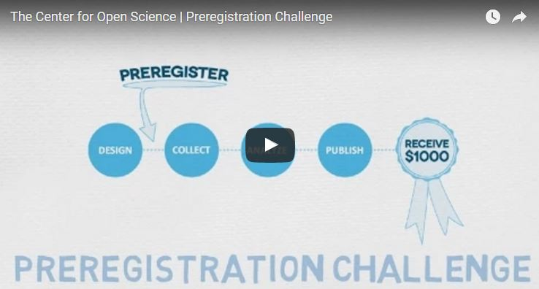
Pre-registration
COS Preregistration challenge
https://aspredicted.org/
Journal of Business and Psychology’s Hybrid Registered Reports

Slide 27
Prospective meta-analyses
Preregister the nature of the study; receive feedback; refine the preregistration; get approval.
Get multiple laboratories to participate in the approved study.
Have all labs follow the protocols.
Results are then meta-analyzed.
But note that this meta-analysis follows a pre-designed plan allowing for more benefits than a traditional post-hoc meta-analysis of studies (e.g., labs, samples, measures, manipulations can be planned out).

Slide 28
Transparency in Measure Sharing and Adaptation
IO has its strengths in terms of psychological measurement, developing and requiring measures with psychometric integrity. Good measures improve understanding of the construct (reliability) and understanding of prediction (validity)
Measure development studies go through extensive steps (content generation, refinement, data-gathering for reliability, further refinement, data gathering for validity).
This process give credence to the measure and hope that future researchers find the measure works well in other settings….

Slide 29
Transparency in Measure Sharing and Adaptation
...but then what actually happens to that measure in research and practice? (work by Eric Heggestad and George Banks)
Removal of items, alteration of items, etc.
Need to be open in sharing all measures, discourage ad hoc variation, yet encourage sharing to find variations that are similar (e.g., shorter measures).

Slide 30
Conclusions
Open science is a “push” on multiple fronts to improve psychological science (I-O and beyond).
We should incorporate I-O practice and practitioners in our own OS push. Practice depend on the credibility of the science, to organizations, in litigation, to policy makers, to the general public.
Perennial questions will be revisited under the OS banner: e.g., How do we define RRR; what approaches will encourage it; by what standards should we judge research as RRR; how do we reduce game-playing?

Slide 31
OS = publication,
tenure, attention,
glory, $
A happy researcher engaged in OS. Improved research is aligned
with desired incentives. We – and science – can sleep better!

Slide 32
THANK YOU!
THANK YOU!
Fred Oswald
President, SIOP (Div. 14)
Check us out!
www.siop.org
Rice University
foswald@rice.edu
www.owlnet.rice.edu/~foswald

